Slide 1
py.test for qa automation
Wilson Liu
2015/03/06

Slide 2
Contents
Python Unit Test
Test Framework
Test Case Naming Convention Format
py.test Introduction
TLib
Project Examples

Slide 3
Python Unit Test
Doctests
Unittest
Nosetests
py.test

Slide 4
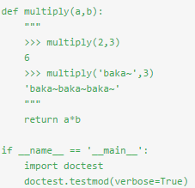
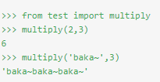


Doctests
unnecessary_math.py
Mod1: Test code in src Mod2: Test code in a file

Slide 5
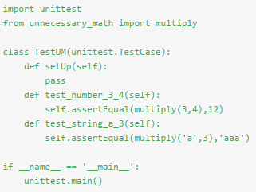
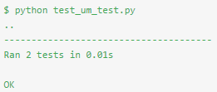
Unittests
test_um_test.py

Slide 6
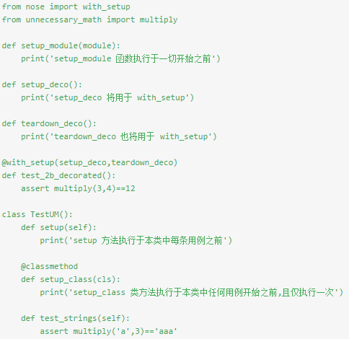
Nosetests
test.py

Slide 7
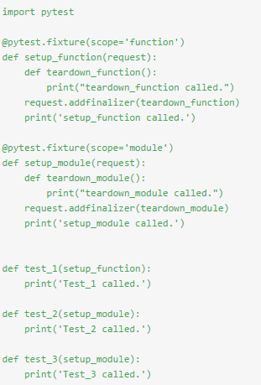
py.test
some_test.py

Slide 8
Test Framework
Config
Lib
Logs
Resources
Testcases
Requirement.txt

Slide 9
Test Case Naming Convention Format
FA | 2 character acronym representing the Functional Area of the product.
 |  | 999 | 3 character incremented numeric, corresponding to the Group of tests within the Functional Area being tested.
 |  |  |  | 999 | 3 character numeric Test Number incremented within the Group

Slide 10
Py.test Introduction
Main Features
runs on Posix/Windows, Python 2.6-3.4, PyPy and (possibly still) Jython-2.5.1
well tested with more than a thousand tests against itself
strict backward compatibility policy for safe pytest upgrades
comprehensive online and PDF documentation
many third party plugins and builtin helpers,
used in many small and large projects and organisations
comes with many tested examples

Slide 11
Py.test Introduction
Install
pip install -U pytest
easy_install -U pytest
Check
$ py.test --version

Slide 12
Py.test Introduction
Run your py.test
Use py.test Command
py.test -s som_test.py
py.test somepath
Use IDE, such as JetBrains PyCharm Community
Configure ‘Test Runner’
Configure py.test ‘Working directory’

Slide 13
Py.test Introduction
Command
py.test --version # shows where pytest was imported from
py.test --fixtures # show available builtin function arguments
py.test -h | --help # show help on command line and config file options
py.test --maxfail=2 # stop after two failures
py.test test_mod.py # run tests in module
py.test somepath # run all tests below somepath
py.test -v -m webtest # run maker ‘webtest’ test cases
py.test -v test_server.py::TestClass::test_method
py.test --cov=path/to/package --cov-report=term --cov-report=html
……

Slide 14
Py.test Introduction
Raising a specific test outcome
fail
skip
raise

Slide 15
Py.test Introduction
Fixtures Defination
fixture(scope=’function’, params=None, autouse=False, ids=None)
(return a) decorator to mark a fixture factory function.
Usage
1) This decorator can be used (with or or without parameters) to define a fixture function.
2) The name of the fixture function can later be referenced to cause its invocation ahead of
running tests: test modules or classes can use the pytest.mark.usefixtures(fixturename) marker.
3) Test functions can directly use fixture names as input arguments in which case the fixture instance returned from the fixture function will be injected.

Slide 16
Py.test Introduction
Purpose of fixtures
fixtures have explicit names and are activated by declaring their use from test functions, modules, classes or whole projects.
fixtures are implemented in a modular manner, as each fixture name triggers a fixture function which can itself use other fixtures.
fixture management scales from simple unit to complex functional testing, allowing to parametrize fixtures and tests according to configuration and component options, or to re-use fixtures across class, module or whole test session scopes.

Slide 17
Py.test Introduction
Common usage of fixtures
Fixtures as Function arguments
Sharing a fixture across tests in a module (or class/session)
fixture finalization / executing teardown code

Slide 18
Py.test Introduction
Marking test functions with attribute
skipif - skip a test function if a certain condition is met
xfail - produce an “expected failure” outcome if a certain condition is met
parameterize to perform multiple calls to the same test function.
Working with custom markers
Marking test functions and selecting them for a run
Selecing tests based on their node ID
Marking whole classes or modules
Reading markers
Marking platform specific tests with pytest
Automatically adding markers based on test names

Slide 19
TLib
A distribution that provides a library of tools written in Python to help simplify the creation of automated tests
https://pypi.python.org/pypi/tlib

Slide 20
Project Examples
Now, it’s time to code!
Listen carefully!!!

